Slide 1
Lecture 18: Single Cycle Control
CSE/EEE 230
Chapter 4

Slide 2
5 Classic Component of Computer
Computer
commands datapath, memory & IO according instructions
CPU
Memory
Devices
allows input into computer
Control
Input
Datapath
Output
component of the processor that performs arithmetic operations
allows output from computer
includes internal and external memory

Slide 3
Determining control
What needs to be controlled?
Register write
Memory read/write
Multiplexers
What determines the control?
Combinational logic
Input is instruction
Output is control signals

Slide 4
Our Simple Control
All of the logic is combinational
Need to wait for everything to “settle down” and the correct result produced
ALU might not produce “right answer” right away
Can use write signals along with clock to determine when to write
Cycle time determined by length of the longest path
critical path

Slide 5
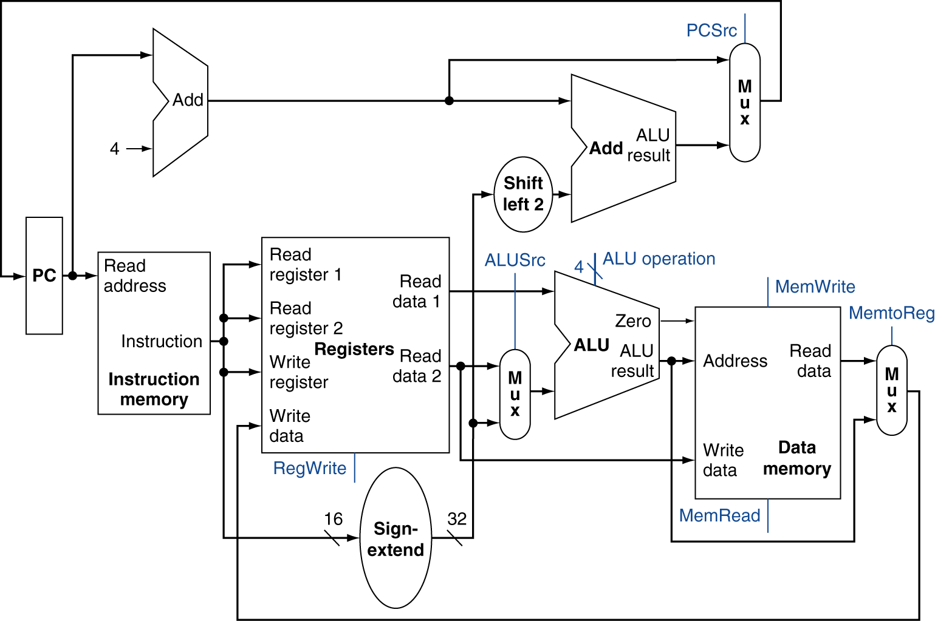
Data path revisited

Slide 6
ALU Control
Input
2 lines indicating type of instruction (ALUop)
6 lines for function code (function code from instruction)
Output
4 lines indicating which operation to perform
possible 16 operations could be specified
less are required
ALU Control Logic
ALUop
ALU Control
Function
code

Slide 7
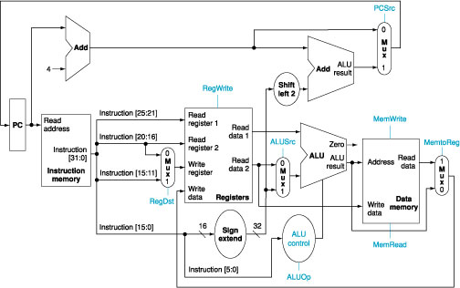
Adding ALU control
remember ALU op is determined by instruction opcode

Slide 8
ALU Control
2 control lines
Determined by opcode
Examples
ALU Op | Instruction | ALU Control | Operation?
00 | lw | 0010
00 | sw | 0010
01 | beq | 0110

Slide 9
ALU Control for r-type
All r-type operations have the same opcode = 000000 so all r-type instructions have the same ALU Op = 10
The function code determines the ALU control
ALUOp | Instr | Function | ALU control
10 | add | 100000 | 0010
10 | sub | 100010 | 0110
10 | and | 100100 | 0000
10 | or | 100101 | 0001
10 | slt | 101010 | 0111

Slide 10
Truth Table
ALUOp1 | ALUOp0 | F3 | F2 | F1 | F0 | Op
0 | 0 | X | X | X | X | 0010 | Add
0 | 1 | X | X | X | X | 0110 | Sub
1 | 0 | 0 | 0 | 0 | 0 | 0010 | Add
1 | 0 | 0 | 0 | 1 | 0 | 0110 | Sub
1 | 0 | 0 | 1 | 0 | 0 | 0000 | And
1 | 0 | 0 | 1 | 0 | 1 | 0001 | Or
1 | 0 | 1 | 0 | 1 | 0 | 0111 | Slt

Slide 11
Logic diagram for (partial) ALU Control

Slide 12
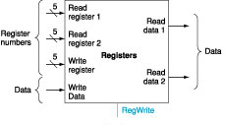
Controlling access to registers
32-bits
op
rs
rt
rd
sh
func
No control on read
Always reads two registers

Slide 13
Controlling write to register
32-bits
op
rs
rt
rd
sh
func
control line RegWrite
= 1 write register
= 0 no write
data from?

Slide 14
Setting the RegWrite control
Remember that RegWrite controls whether or not a register should change.
What should be the value of RegWrite for the following?
r-type
sw
lw
beq
j

Slide 15
Problem -
What registers are read?
What register is written?
What would RegWrite control line be?
000000 10001 10010 01000 00000 100000

Slide 16
RegDst Control
What does the RegDst control?
Why is it needed?

Slide 17
Setting the RegDst control
Remember that RegDst controls which register is written.
What should be the value of RegDst for the following?
r-type
sw
lw
beq
j

Slide 18
Controlling input into ALU

Slide 19
Setting the ALUSrc control
Remember that ALUSrc determines what is the second input into that ALU.
What should be the value of ALUSrc for the following?
r-type
sw
lw
beq
j

Slide 20
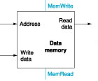
Memory
Read data
address 32 bits
memread
Write data
address 32 bits
data 32 bits
memwrite

Slide 21
Setting the MemRead & MemWrite control
What should be the value of MemRead and MemWrite for the following?
r-type
sw
lw
beq
j

Slide 22
Controlling source of input into register

Slide 23
Setting the MemToReg control
Remember MemToReg controls the source of the input into a register.
What should be the value of MemToReg for the following?
r-type
sw
lw
beq
j

Slide 24
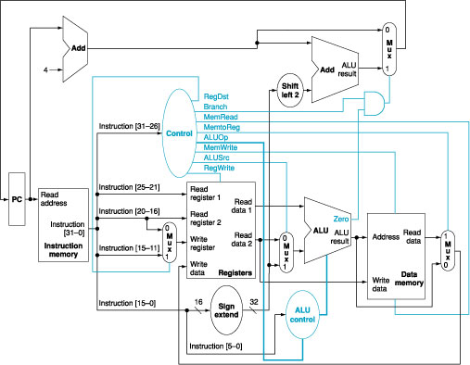
Adding the control unit

Slide 25
Bringing it together

Slide 26
Logic diagram for control lines

Slide 27
What about branching?
beq $t1, $t2, offset
steps
fetch instruction and increment PC (control?)
read $t1 and $t2 (control?)
subtract values (control?)
PC + 4 is added to sign-extended lower 16 bits of instruction (control?)
zero result from ALU is used to determine value in PC (control?)

Slide 28
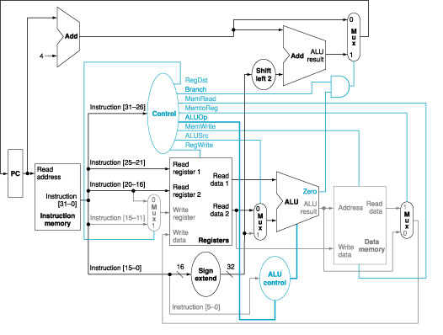
Control with branch

Slide 29
What about jump?
opcode = 000010
remainder of instruction is address
26 bits
need to
shift bits 2 to left
replace lower 28 bits of PC
what control needs to be done?
can shifting always be done?
where does decision need to be done?

Slide 30
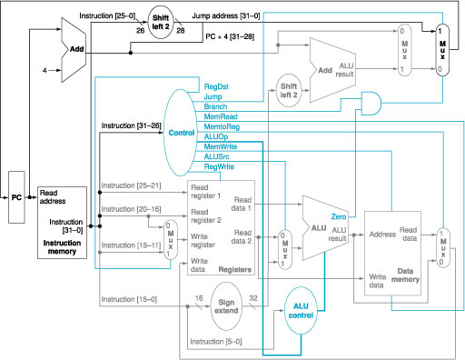
“complete” picture

Slide 31
Performance Issues
Longest delay determines clock period
Critical path: load instruction
Instruction memory → register file → ALU → data memory → register file
Not feasible to vary period for different instructions
Violates design principle
Making the common case fast

